Slide 1

Kanexpro
SEO Monthly Performance Report
April 2026

Slide 2
Table Of Content
● Top Pages Traffic
● City-Wise Traffic
● Acquisition Overview
● Event Overview
● Organic Search Clicks
● Search Queries
● Keyword Ranking

Slide 3
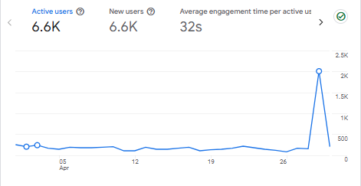
Website Users Overview

Slide 4
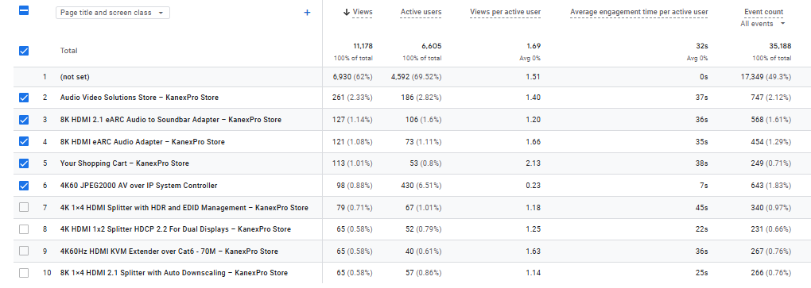
Top Pages Traffic

Slide 5
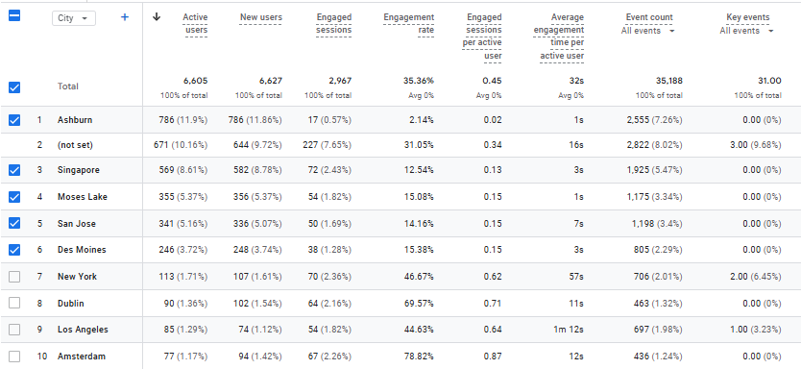
City-Wise Traffic

Slide 6
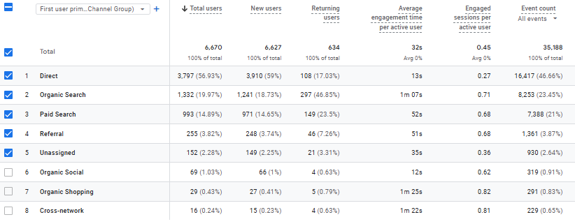
Acquisition Overview

Slide 7
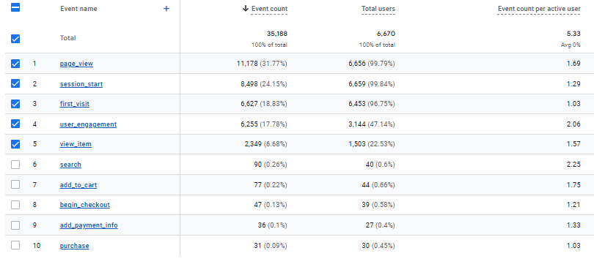
Event Overview

Slide 8
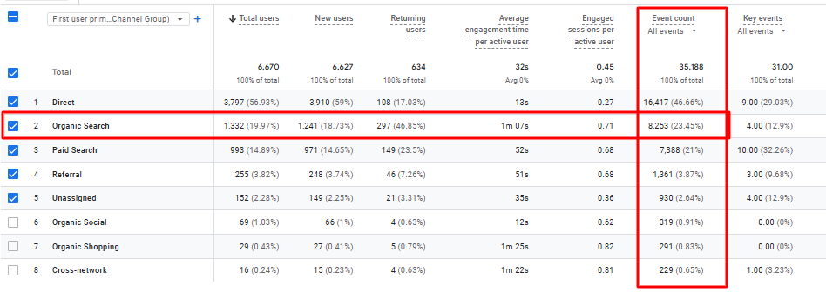
Key Events

Slide 9
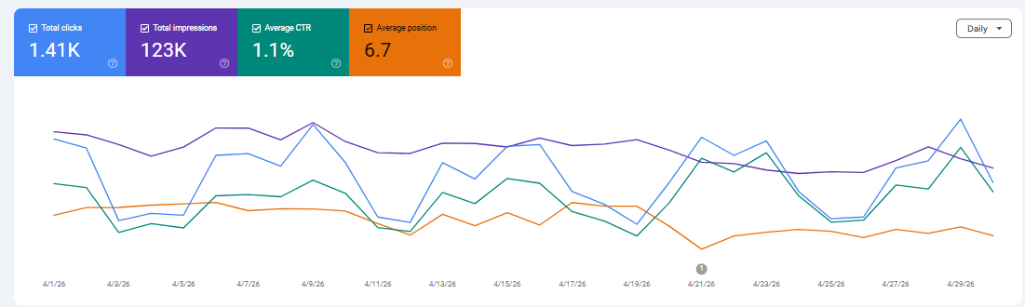
Organic Search Clicks

Slide 10
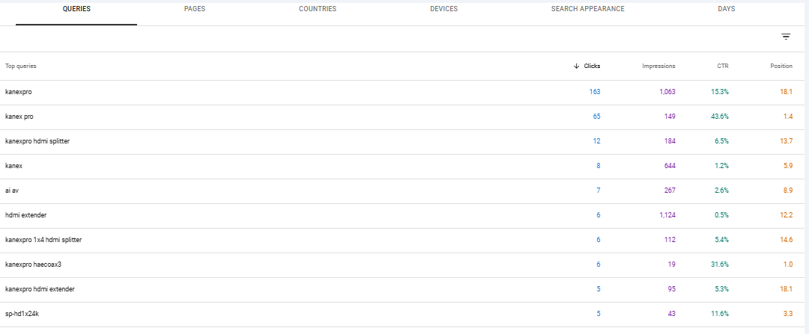
Organic Search Queries

Slide 11
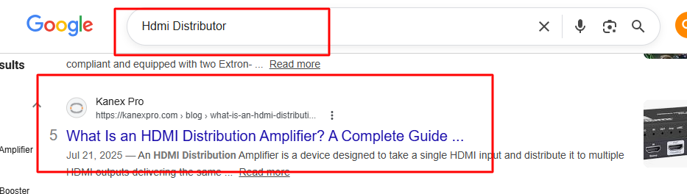
On-site Blog Ranking on 1st Page

Slide 12
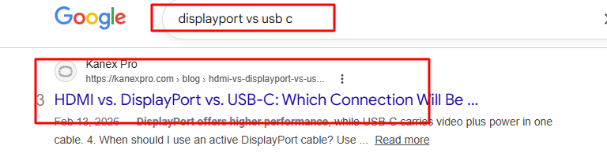
On-site Blog Ranking on 1st Page

Slide 13
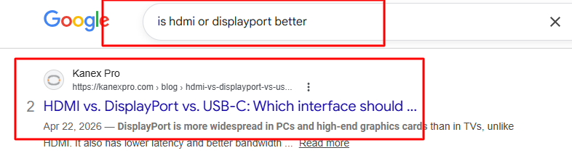
On-site Blog Ranking on 1st Page

Slide 14
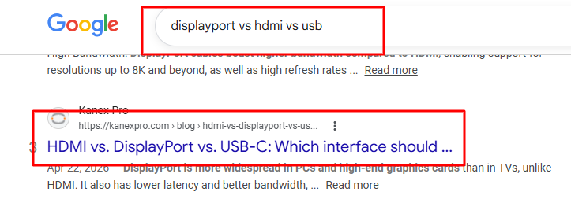
On-site Blog Ranking on 1st Page

Slide 15
Keyword Ranking
Keyword | April 2026
kanexpro 1x4 hdmi splitter | 1
is hdmi or displayport better | 2
displayport vs hdmi vs usb | 3
displayport vs usb c | 3
hdmi amplifier | 4
hdmi distributor | 5
usb c vs hdmi for monitor | 5
what is an hdmi extender | 5
hdmi versus displayport | 5

Slide 16
https://kanexpro.com/
Thank You

